Slide 1
Virtual Exchange A Pilot Program
Rotary District 6600 Ohio Pathways e-Club
Cultural Connection Program
Notes:
Introduce self. Give credit to Ohio presentation which I heard at YEO Preconference last year, California District and Rich Friedman

Slide 2
What Is a Cultural Connection?
IS an alternative to in-person exchanges as Rotary Fellowships or Rotary Youth Exchange
IS facilitated, IS structured, IS safe
HAS specific goals and outcomes
IS short duration
WILL enhances cultural understanding
Notes:
Alternative to in-person exchange, something that can be done in this time of COVID.

Slide 3
A Cultural Connection ……
Is NOT a replacement for the current Youth Exchange programs
Does NOT include a scholastic component
Does NOT require participants to be sponsored by a certified district
Does NOT require participants to be ranked in any specific category
Does NOT require a financial contribution of participants or Club
Is NOT a language program

Slide 4
Goals
Promote diversity and inclusion
Facilitates meaningful discussions between participants of different countries
Development of global competencies and leadership skills
Allows Rotary members and non-members to be involved
Notes:
Includes those students who due to financial, physical constraints might not be able to participate in an in-person exchange

Slide 5
Time Frame
Quarterly exchanges, continuous unless formally interrupted
Start time to be mutually agreed on by all parties based on first full week of second month of each quarter
Participants may wish to continue communication further if mutually agreed upon by participants, however Rotary involvement will end
Notes:
The June start date would allow students to finish with school before starting the program. ESSEX chose the August 31st date as an ending point. This would be about the same time frame as a short term exchange.

Slide 6
Eligibility
Students ages 13 to 18
Adults 19+
Participation regardless of ethnicity, gender identification, family structure, etc.

Slide 7
Technical Requirements and Time Commitment
Home computer or iPad with video capability
Reasonable quality internet connections
Able to commit to 2-3 hours per week actual online meeting
Time for preparation of activities
Notes:
The one hour time frame for a meeting may be dependent on the program used. A free zoom account will allow for a 40 minute conversation.

Slide 8
Process
All District 6600 Youth Program Policies and Procedures apply to Cultural Connections, including Volunteer Training, Application, Background Check and any of the incident reporting, including the “virtual” incidences as cited in the Cultural Connections Application.

Slide 9
Application Process
Participant will complete an application found on the e-Club Website. Included in the application are:
Rules and Conditions of Exchange (which includes prohibited internet behaviors)
Student & Parent Acknowledgement of Rules and Conditions when applicable
Consent to Use Personal Data, Images and Recordings after the program
ends for promotional activities

Slide 10
Process Continued
After application is submitted to the Club, an interview with student and parents is established followed by a selection or offering of exchange country and exchange quarter
Country selection – While participant may request a specific country, the hope is to be open to the experience, wherever the match may be.
Select portion of participant portfolio will be made available to counter-part country for review
Match made
Participants and Rotary volunteers decide on a mutually agreeable date to begin the program starting with first full week of the second month of each quarter

Slide 11
Adult Supervision
All adults involved in this program must submit an application (found & managed on the Ohio Pathways club website) and be vetted.
Parents would supervise the remote conversations, ensuring the conversations are appropriate and interactive
Oversight for service project will be done by the Program Counselor
While the Program Facilitator will be needed for the ZOOM portion of the exchange and discussion topics, the goal is for the students to fully engage with each other during and after the exchange
Notes:
This vetting of all adults is a RI Youth Protection mandate.

Slide 12
Communication and Adults
To ensure communication (texts, emails, etc.) is appropriate and transparent between volunteers and participant, all communication should include the student’s parents and the adult e-Club volunteers
Adults should not maintain private social media communication with a student partisipant
Notes:
Ongoing communication occurring outside the parameters stated could be a warning of inappropriateness of the communications

Slide 13
Orientation
All volunteers and students will have an orientation conducted by the e-Club Program Trainer to include:
Discuss Rotary and other programs
Discuss Internet Safety
Discuss exchange expectations and rules
Introduce volunteers
Discuss schedule and potential activities
Discuss service project

Slide 14
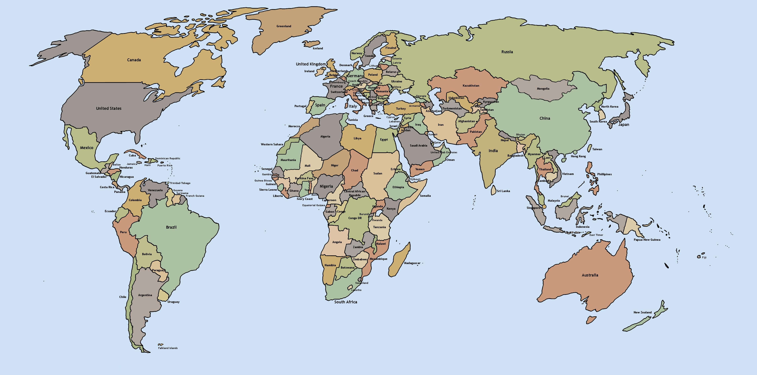
Countries Interested at this time
Japan
Taiwan
Germany
Finland
Australia
South Africa
Notes:
With RI’s position on in-person exchange, I anticipate more countries participating. The Virtual Exchange will also be part of the YEO Preconference for the Rotary International Conference

Slide 15
Potential Topics for Discussion
Introducing self and family
Introduce information about country/locality
Life in the day of -
How festivals/holidays are celebrated
Virtual tour of home and area
Foods of your country/favorite foods/cooking demonstration
Language skills practice (includes slang & idioms)
Future plans
Notes:
These may be videos

Slide 16
Proposed Schedule
Week One – Introductions of student and family; discussion on where they live, country and town, program goals & expectations, rules, calendar, home & school stories
Week Two – PDA video production of community, presentation by former exchange student, discussion on community service and identification of a service project
Week Three – Talent week, video presentations, Service Above Self, discussions on country’s history, government structure, popular songs and holiday differences
Week Four – Decision on language, local slang, idioms and communications, review of presentation techniques, Rotarian (former exchange student) on personal impact of an exchange
Week Five – Presentation on involvement of service project, student feedback on exchange experience with recommendations, Graduation program
Notes:
School tour might be outside of building. This is just a potential schedule. The hope is the students will engage and find more topics to discuss

Slide 17
Some Suggestions for Service Project
Contact local Rotary Club for suggestions
Food pantry
Park clean up
Host a fund raiser and donate money
Clean up a garden
How to develop a Pollination Garden
Help an elderly neighbor

Slide 18
Evaluation
Development planned following the first exchange based on all participant feedback
Notes:
This would be done at the end of the program to evaluate the potential for a continuation of the program. Again, this would allow students who due to different circumstances might not be able to do a physical exchange. There is also discussion to lower the age to 14, hoping to spark, more interest in the exchange program. Share screen for evaluation

Slide 19
Contact Information
Kristine Wilson – Club YEO
curtiskrisandeli@gmail.com
614-560-6340

Slide 20
Thank you

